Slide 1

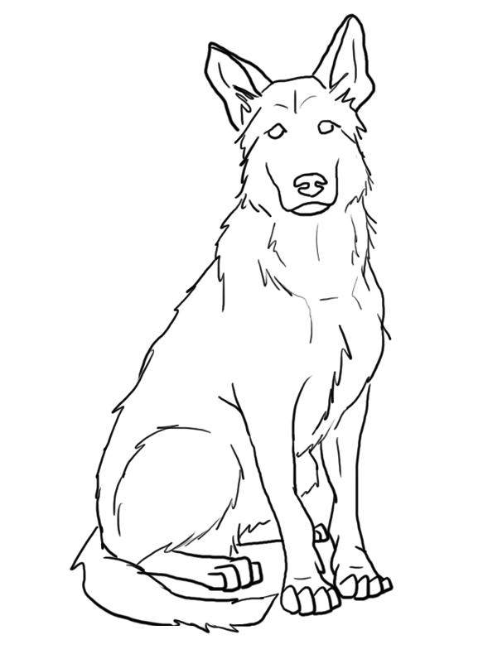
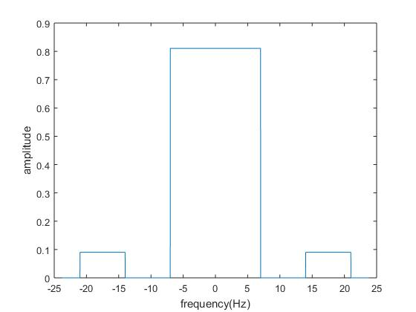
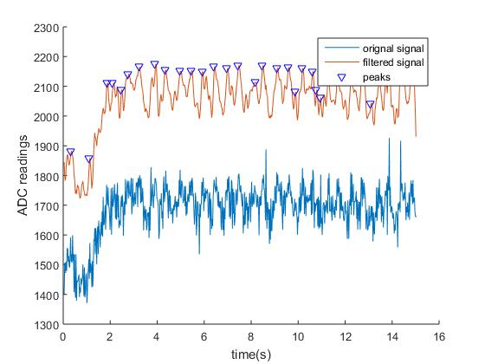

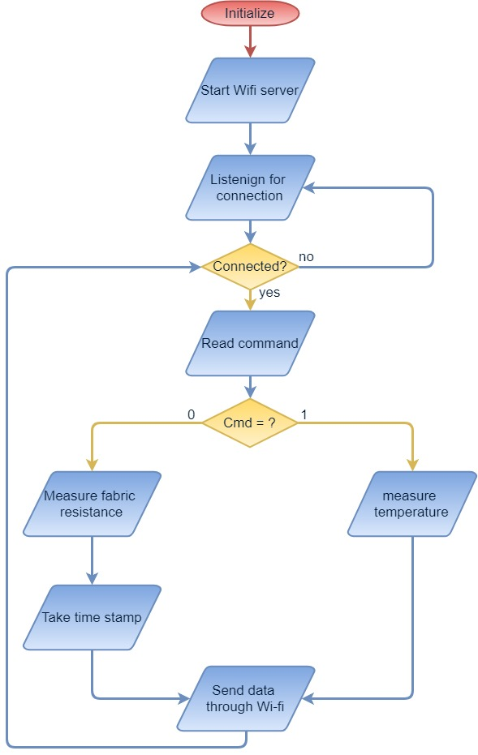
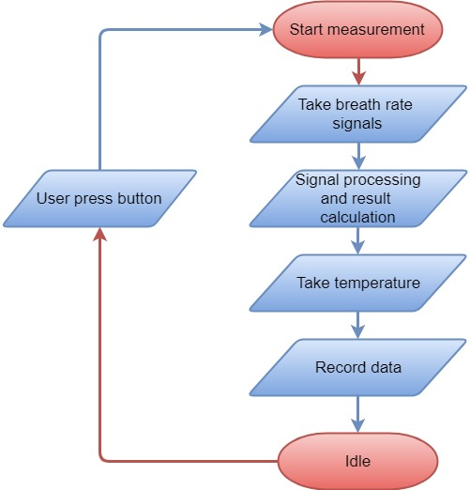
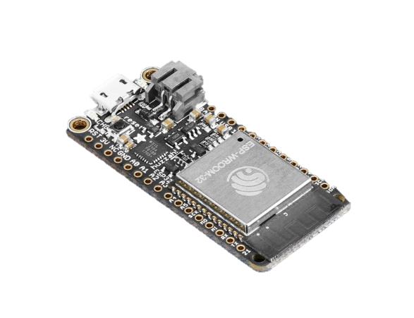

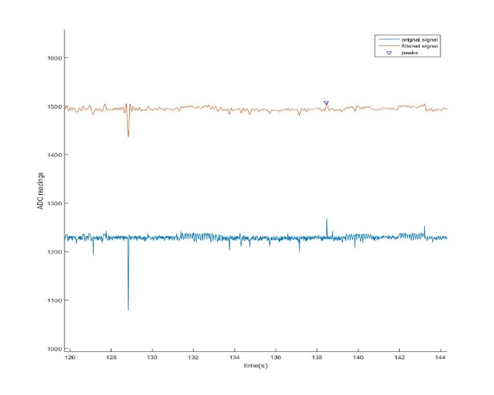

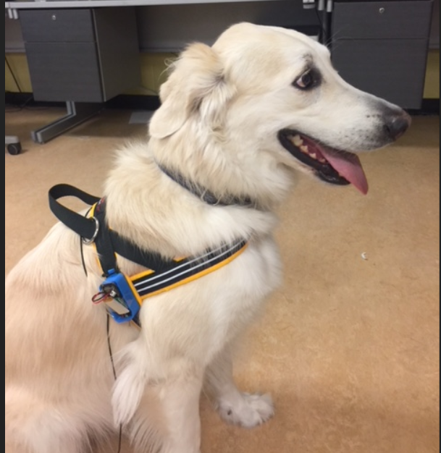


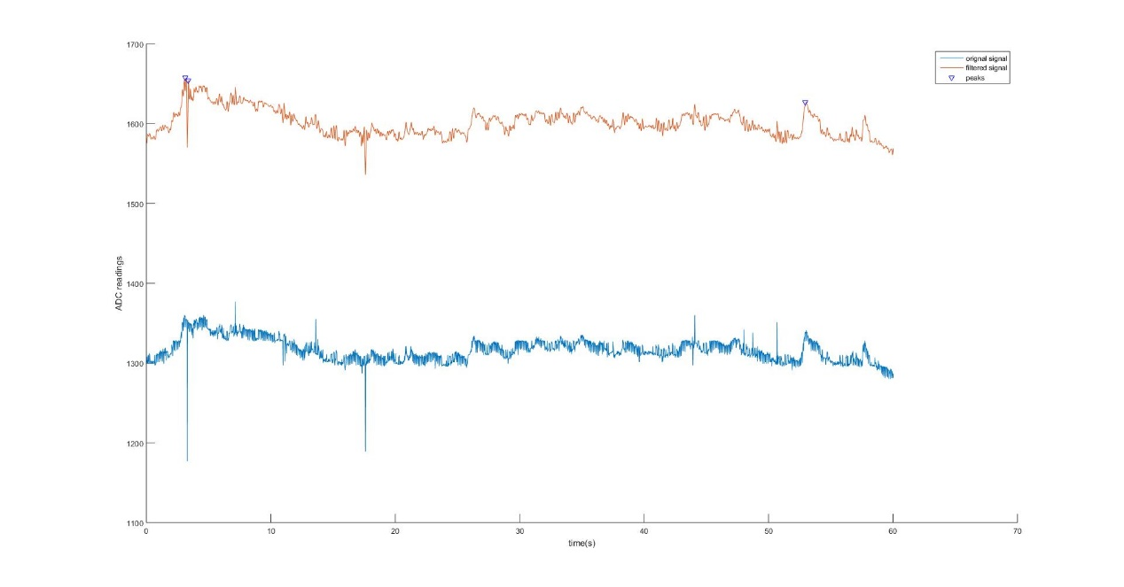
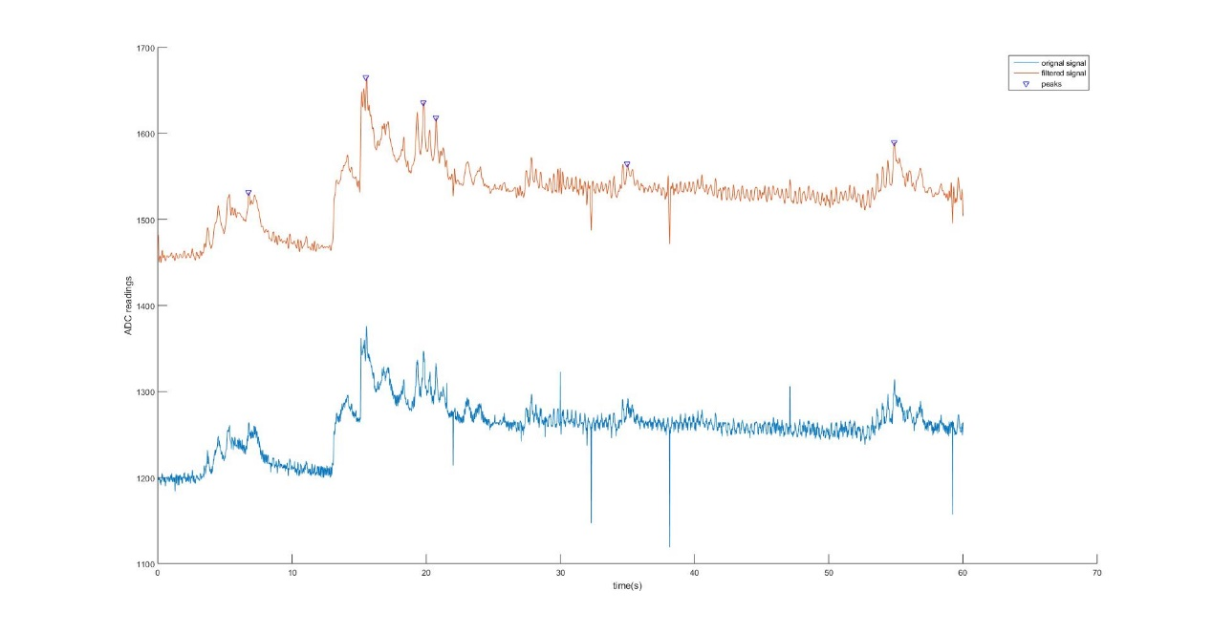



A Non-Invasive Wireless Respiratory Monitoring System for Animals
K. Qiao, A. Nickerson, S. MacDonald, E. Ghafar-Zadeh
Dept. of EECS, Dept. of Psychology, York University, Toronto, Canada
Biologically Inspired
Sensors and Actuators
1
2
2
1
BioSA
1
2
Abstract
Hardware
Software
Signal Processing
The main objective of the project is to develop a biomedical device that can noninvasively monitor a dog’s breath rate using a conductive fabric. Nowadays more and more people are keeping dogs as their loyal companions. The number of pet dogs has increased from 68 million in 2000 to 89.7 million by 2017. As such the need for simple reliable and cheap heart rate sensor for dogs will also be increasingly demanded. Our device can really simplify the dog heart rate sensing technology making them more affordable and reliable for a dog or even other pet owners. The approach towards this project is to measure the breath rate of a dog which is related to its heart rate by detecting the movement of the dog’s chest. The resistance of the fabric will vary as the dog’s chest stretches the fabric. Using a resistance to voltage convert circuitry, we generate a voltage signal that is correlated with the movement of the dog’s chest. This signal is captured using a microcontroller and then together with the temperature readings from a temperature sensor they will be sent over to a computer wirelessly for further process and analysis. This custom-made sensor-microcontroller device is attached to a dog harness. Finally, in our computer, we would filter out all the noises and measure the number of pulses which represents the breath rate from the signal. The recorded data can be used in analyzing, diagnosing and improving the dog’s health conditions.
The hardware mainly consists of an Adafruit HUZZAH32 board, a 350mah lithium polymer battery, and a power switch. The Adafruit HUZZAH32 board carries an ESP32 microcontroller, with an Xtensa dual-core 32-bit LX6 microprocessor, 2 analog to digital converter and Wi-Fi capability. The sensors we used are the Adafruit Conductive Rubber Cord Stretch Sensor and a DS18B20 Digital Temperature Sensor. The sensor data will be collected by the microcontroller and send to the computer through Wi-fi.
The server program was developed using Arduino IDE. Details of how to set up and develop in Arduino IDE can be found on Adafruit website (Ada, 2017). The server program logic is shown in the following flow chart Fig. 3 (a). On the PC side, before starting the client, we need to first enable the Wi-fi hot spot in our laptop. The hot spot needs to have the same name and password as specified in the server program. The client program was developed with MATLAB Instrument Control Tool Box and GUIDE. After the program is finished the MATLAB application compiler will package it into a standalone application. There are four steps after the user pressed the start measurement key. Detail is shown in the following flow chart Fig. 3 (b).
The breath rate signal is expected to be around 1-2Hz with a triangular shape. As such a low pass filter with 7Hz of the cutoff frequency was applied here. To preserve the triangular shape of the expected wave form, additional harmonics were added. Overall, the filter can be described by the equation:
$$\sum_{i}^{n}{\frac{4}{π^{2}}\frac{1−{(−1)}^{n}}{n^{2}}} (f∈[(n−1) ,n]×7(Hz))$$
The following plot shows the shape of the filter in the frequency domain and the effectiveness of the filtering
3.3v VDD
10kOhm
Rubber cord(in blue)
(a)
(b)
Fig. 4 (a) Filter in frequency domain (b) Filtering effectiveness
Conclusions
In this project, we developed a wearable breath rate sensor with a wireless communication capability for dogs. We demonstrated our capability to collect breath rate data and transmit them through Wi-fi. However, due to the non-idealities of the signal measured from the dog, such as muscle movement, device vibration or any form of an unexpected stretch of the rubber cord will cause a disturbance, thus resulting in inaccurate measurement of breath rate. We would still need to further improve our signal processing of the raw data and the pulse recognition and counting mechanism. As the continuation of this work, aside from the improvement previously mentioned, we will be adding more diagnostic tools for measuring dogs’ heart rate. Such as measuring heart rate variability of a dog.
(b)
Microcontroller
(a)
Fig. 3 (a) Server flow chart
(b) Client flow chart
Fig. 2 Device hardware
Results
We mounted the device on a dog harness, as such we were able to mount the device on the dog. We took the measurement under 2 scenarios , (1) The dog lay down at rest, (2) The dog standing still. The device can measure the signal at 45-50Hz sampling frequency within a range of roughly 20m radius.
Acknowledgements
I would like to express my deepest appreciation to Amanda Nickerson and Suzanne MacDonald for providing an application for this project and dogs for testing.
And also I want to say thank you to professor Ebrahim, for giving me a lot of guidance and support during this project.
Finally this research is approved by ACC at York University
Microcontroller
Filtered signal
References
Rubber cord
Original signal
APPA. "Number of Dogs in The United States from 2000 to 2017 (in Millions)." Statista - The Statistics Portal, Statista, www.statista.com/statistics/198100/dogs-in-the-united-states-since-2000/, Accessed 15 Aug 2018
Ada, L. and Nosonowitz, D. (2017). Adafruit HUZZAH32 - ESP32 Feather. [online] Adafruit. Available at: https://learn.adafruit.com/adafruit-huzzah32-esp32-feather/ove [Accessed 14 Aug. 2018].
Fig. 1 Dog wearing the device
(a)
(b)
Fig. 5 testing results when (a) dog is lying down (b) dog is standing
Undergraduate Summer Research Conference, August 15th 2018, Bergeron Centre for Engineering Excellence, York University

